Slide 1
NLP

Slide 2
Machine Translation
The Noisy Channel Model

Slide 3
The Noisy Channel Model
Source-channel model of communication
Parametric probabilistic models of language and translation

Slide 4
Statistics
Given f, guess e
f
e
E → F
F → E
e’
encoder
decoder
e’ = argmax P(e|f) = argmax P(f|e) P(e)
e
e
translation model
language model

Slide 5
Statistical MT
Translate from French: “une fleur rouge”?
 | p(e) | p(f|e) | p(e)*p(f|e)
a flower red
red flower a
flower red a
a red dog
dog cat mouse
a red flower

Slide 6
Statistical MT
Translate from French: “une fleur rouge”?
 | p(e) | p(f|e) | p(e)*p(f|e)
a flower red | Low
red flower a
flower red a
a red dog
dog cat mouse
a red flower

Slide 7
Statistical MT
Translate from French: “une fleur rouge”?
 | p(e) | p(f|e) | p(e)*p(f|e)
a flower red | Low
red flower a | Low
flower red a | Low
a red dog | High
dog cat mouse | Low
a red flower | High

Slide 8
Statistical MT
Translate from French: “une fleur rouge”?
 | p(e) | p(f|e) | p(e)*p(f|e)
a flower red |  | High
red flower a
flower red a
a red dog
dog cat mouse
a red flower

Slide 9
Statistical MT
Translate from French: “une fleur rouge”?
 | p(e) | p(f|e) | p(e)*p(f|e)
a flower red |  | High
red flower a |  | High
flower red a |  | High
a red dog |  | Low
dog cat mouse |  | Low
a red flower |  | High

Slide 10
Statistical MT
Translate from French: “une fleur rouge”?
 | p(e) | p(f|e) | p(e)*p(f|e)
a flower red | Low | High | Low
red flower a | Low | High | Low
flower red a | Low | High | Low
a red dog | High | Low | Low
dog cat mouse | Low | Low | Low
a red flower | High | High | High

Slide 11
Noisy Channel Model Applications
Text-to-text (e.g., text summarization)
Speech recognition
Spelling Correction
Optical Character Recognition
P(text|pixels) = P(text) P(pixels|text)

Slide 12
Machine Translation
Word Alignment

Slide 13
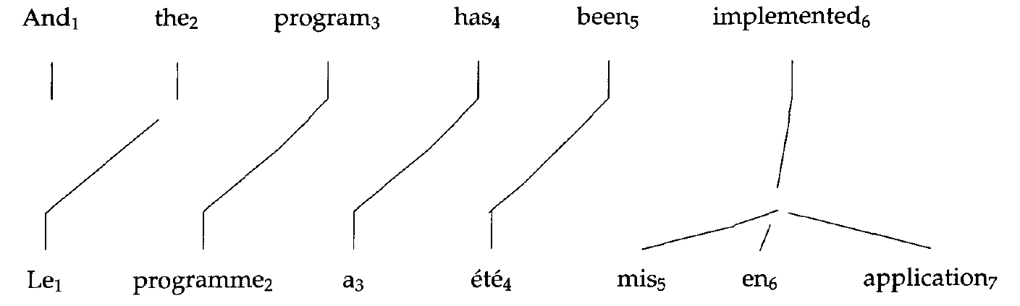
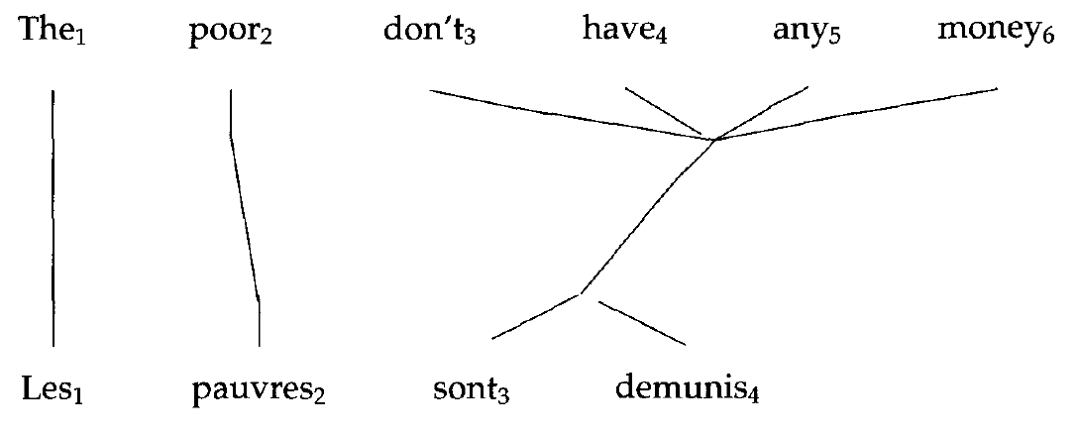
Examples
From [Brown et al. 1993]

Slide 14
Representing Word Alignments
 | le | programme | a | été | mis | en | application
0 NULL
1 and
2 the
3 program
4 has
5 been
6 implemented
Position | 1 | 2 | 3 | 4 | 5 | 6 | 7
French | le | programme | a | été | mis | en | application
Alignment | 2 | 3 | 4 | 5 | 6 | 6 | 6

Slide 15
Complexity of Alignment
Finding the optimal alignment is NP-hard
Reduction from Traveling Salesman Problem
Each word is a city
Each bigram is a distance from one city to another
Each translation is a complete tour of all cities

Slide 16
NLP

